Slide 1

Financial QA Bot
A Python Package for Intelligent Financial Data Analysis
Team: ParthKumar Patel( Section C), Siddharth Upadhyay(WS), Vanshaj Tyagi(WS)
Course: FE 520 - Introduction to Python
Date: 11th December 2025

Slide 2






Package Overview & Purpose
Financial QA Bot is a comprehensive Python package designed to analyze financial CSV data and provide intelligent insights through:
Natural Language QA
Automated Ratio Calculations
Ask questions in plain English.
Instant financial metrics.
Professional Visualizations
Trend Analysis & Forecasting
Clear data representation.
Identify patterns and predict future.
Its key purpose is to transform raw financial spreadsheets into actionable business intelligence without requiring SQL, advanced programming, or expensive BI tools.

Slide 3


Target Audience & Real-World Applications
Primary Users
Use Cases
Financial Analysts
Quarterly Performance Review
Quick ratio calculations, trend identification, report generation.
Load Q1-Q4 data, generate comprehensive reports with charts.
Small Business Owners / CFOs
Investment Analysis
Performance monitoring, growth tracking, financial health assessment.
Compare 5-year revenue trends, calculate CAGR, visualize growth.
Students & Researchers
Budget Planning
Financial analysis learning, academic projects, data exploration.
Analyze historical expenses, forecast next period, identify anomalies.

Slide 4









Module Architecture - The Four Pillars
Data Indexer
CSV data loading, validation, normalization, and summary statistics.
Retriever
Intelligent data retrieval with fuzzy column matching and year-based filtering.
Financial Metrics
Automated calculations for profitability, growth, and efficiency ratios.
Visualizer
Professional chart generation (7+ types) with custom formatting and high-resolution exports.

Slide 5

Detailed Functionality Demonstration
Question Answering
Batch Reporting
bot = FinancialQABot()
bot.load_data("financials.csv")
result = bot.ask("What was revenue in 2023?")
questions = [
"What was revenue in 2023?",
"What was net income in 2022?"
]
report = bot.generate_report(questions)
Output: "Revenue in 2023 was $1,650,000"
Saves JSON report + 9 visualization charts.
Financial Calculations
Advanced Visualizations
metrics = FinancialMetrics()
ratios = metrics.calculate_ratios(data)
cagr = metrics.calculate_cagr(start=1M, end=1.65M, years=4)
Line charts for trends
Waterfall charts for P&L breakdown
Momentum analysis with moving averages
Rolling correlation between metrics
Output: 13.35% CAGR

Slide 6
Comprehensive Error Handling Strategy
Our robust error handling ensures reliability and user-friendly feedback.
File Not Found
load_data("missing.csv")
FileNotFoundError with message
Invalid Column
Ask for "Revenu" (typo)
Fuzzy match + warning
Missing Year
Filter by 2030 (future)
Return None + log warning
Division by Zero
Profit margin with $0 revenue
Try-except + return NaN
Error Handling Principles
Never crash silently: Always log or warn.
User-friendly messages: Plain English to users.
Graceful degradation: Partial results better than total failure.
Validation at boundaries: Check inputs before processing.

Slide 7





Allowed Packages Utilization
Pandas
NumPy
Matplotlib
Datetime
CSV I/O, DataFrame operations, date parsing, statistical summaries.
Numerical computations, array operations, linear regression for forecasting.
All 7+ chart types, custom formatting, high-DPI exports, subplot layouts.
Date parsing, time-series alignment, period calculations for growth metrics.
We strictly adhere to the allowed package list, building on robust, well-documented tools learned in FE 520.
YFinance (Optional): Planned for real-time stock data, benchmarking, and historical price retrieval in a future market_data.py module.

Slide 8

Development & Testing Methodology
Development Process
Testing Strategy
01
Unit Testing
Core Modules (Week 1-2)
Each function tested independently, covering edge cases.
Implement DataIndexer and Retriever with unit tests.
02
Integration Testing
Analytics Layer (Week 3)
Full pipeline testing with real financial datasets.
Build FinancialMetrics, add ratio calculations, validate against Excel.
Error Injection Testing
Deliberately pass invalid inputs to confirm graceful error messages.
03
Visualization (Week 4)
Performance Testing
Create 7 chart types, test with various data sizes, ensure high-quality output.
Load large CSVs (10,000+ rows), measure processing time, optimize bottlenecks.
04
Integration & Polish (Week 5)
Integrate all modules, end-to-end testing, documentation, and examples.

Slide 9
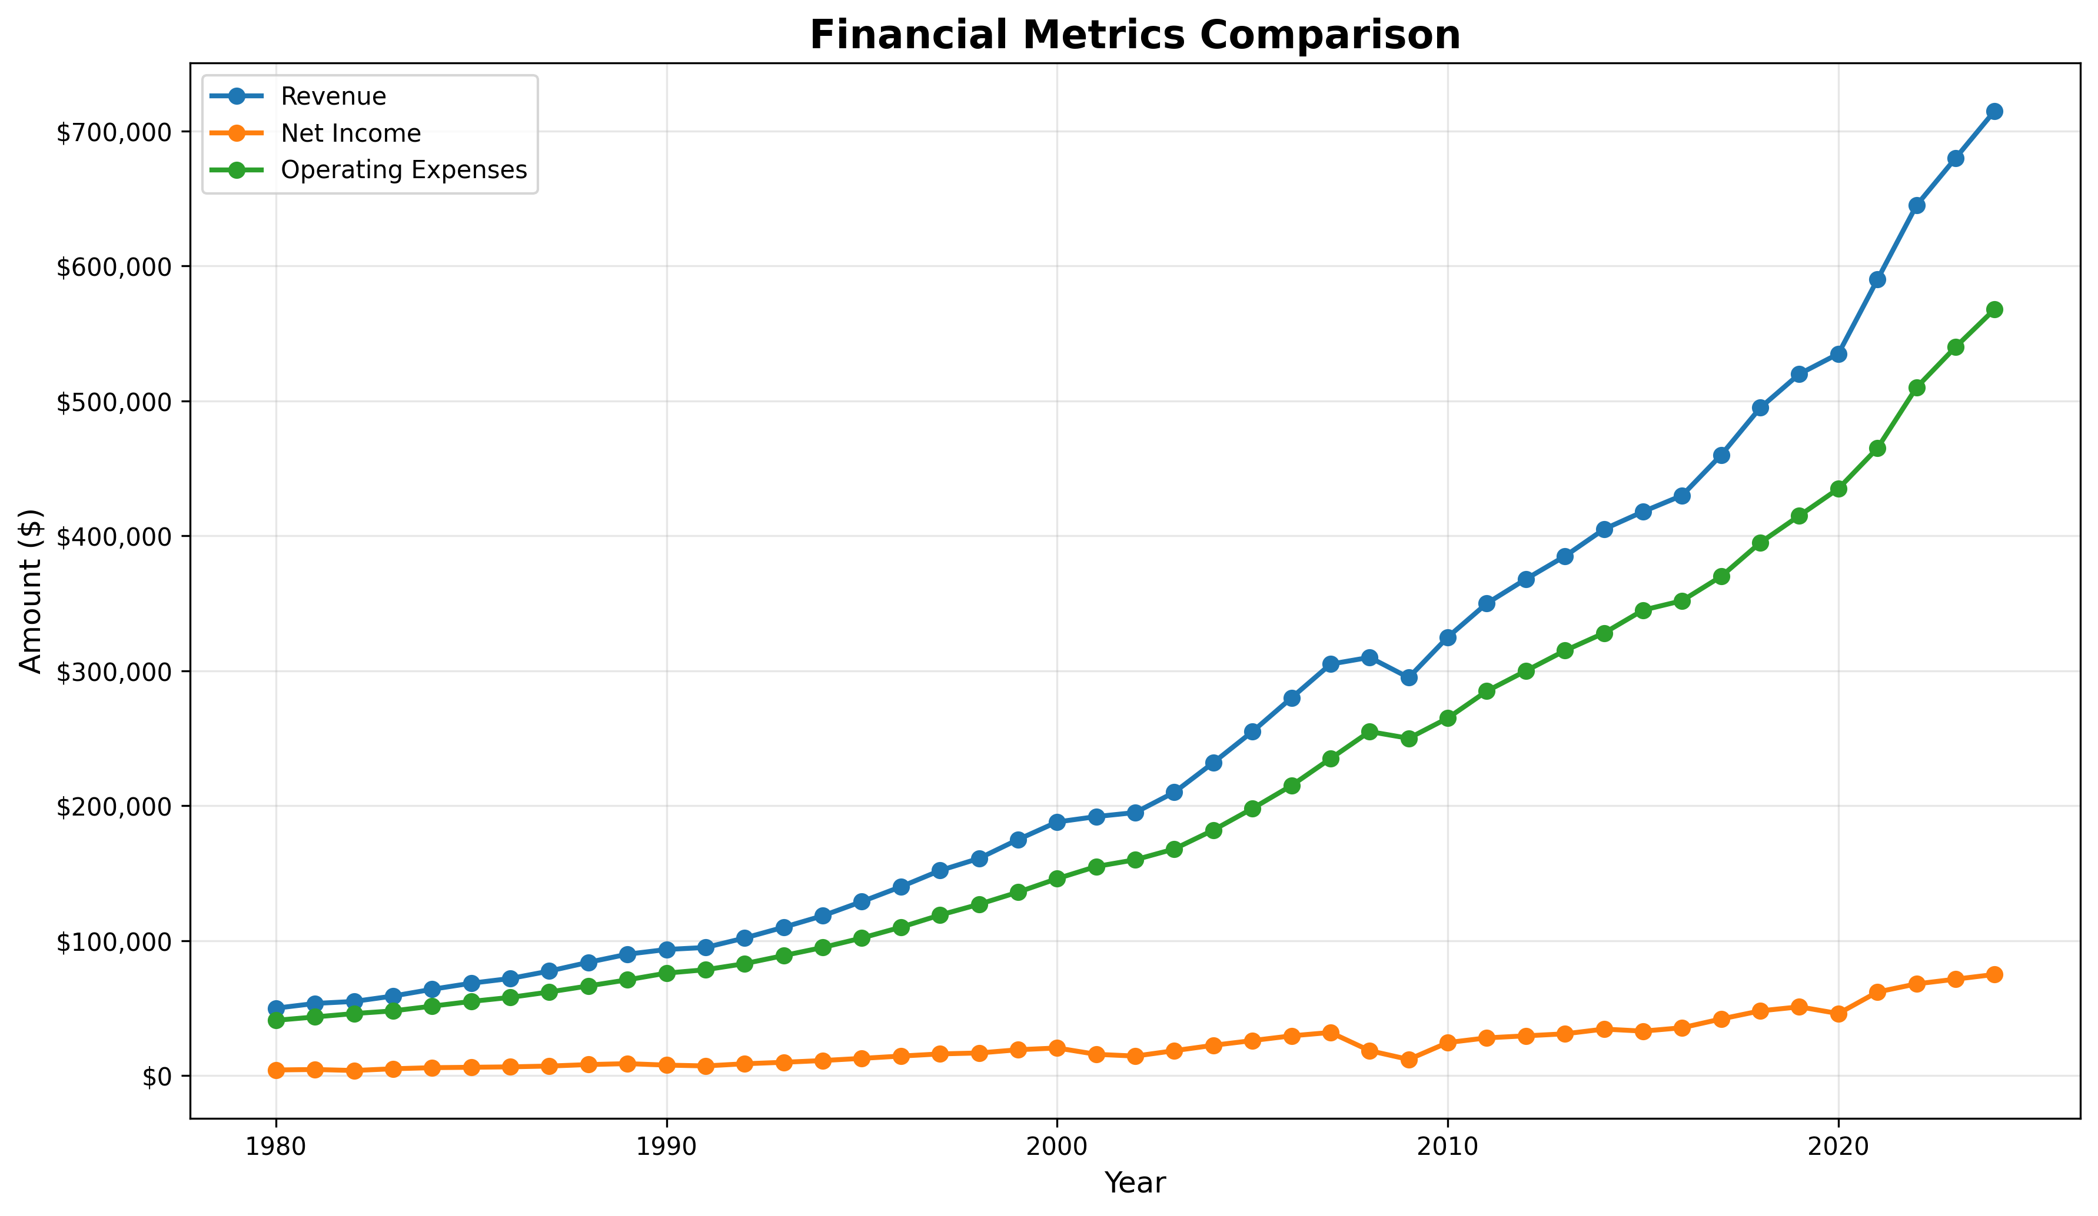
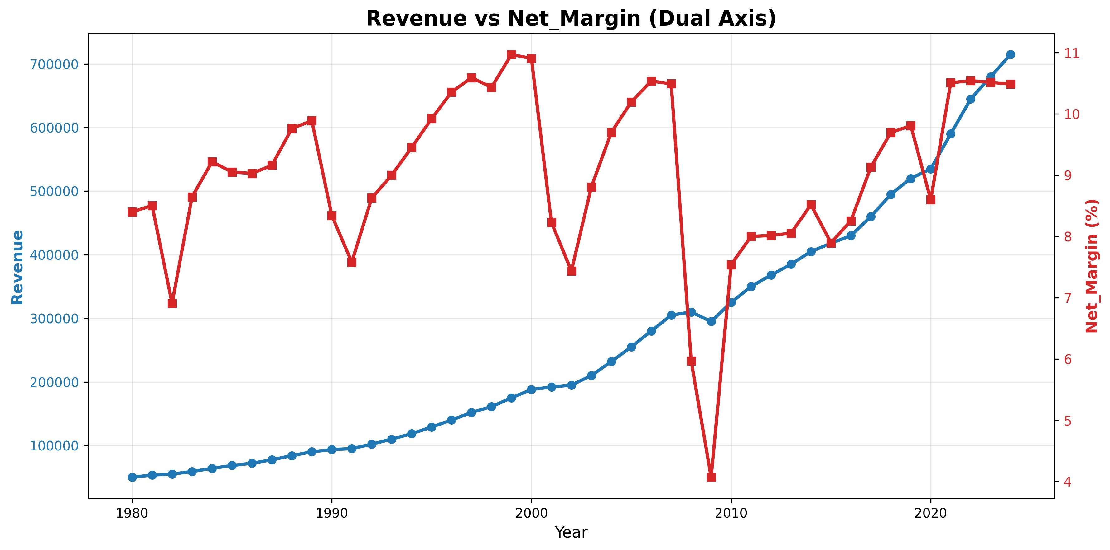
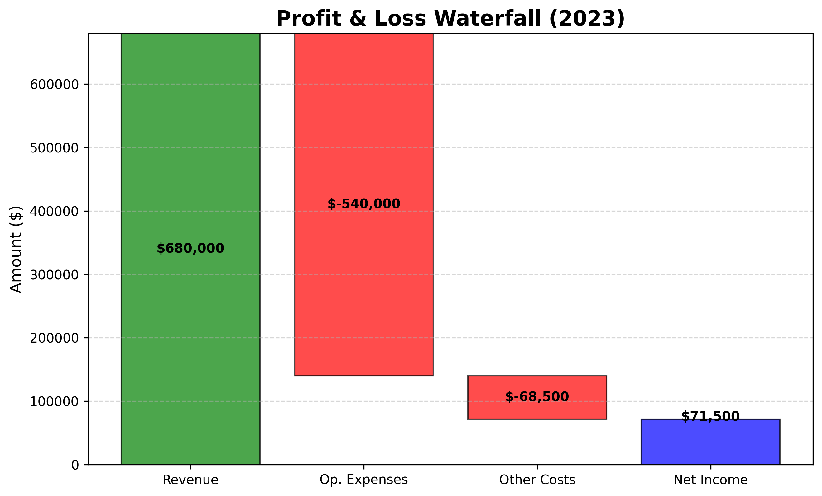
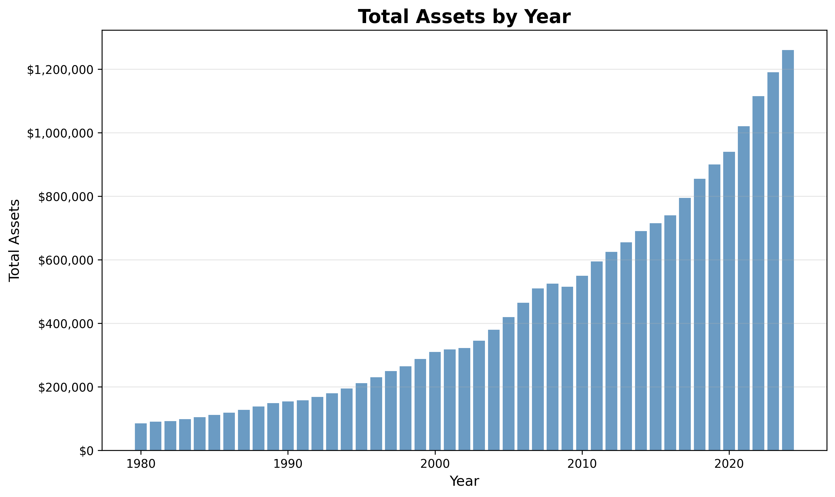

Slide 10
Code Quality & Python Best Practices
Adherence to Python Conventions
Code Quality Metrics
PEP 8 Style Guide
800
45+
4-space indentation, snake_case, clear names, max line length 88 characters.
Lines of Code
Functions
Docstrings (Google Style)
Concise and focused.
Small, testable units.
Comprehensive documentation for functions and modules.
Type Hints
5
30%
Ensuring type safety and improving code readability.
Classes
Comments
Modular Design
Well-defined responsibilities.
Explaining "why," not "what."
Single Responsibility Principle, DRY, clear separation of concerns.
Configuration Management
Config dataclass for centralized settings, environment variable support.

Slide 11
Documentation & Project Deliverables
Comprehensive Documentation
Project Deliverables Checklist
README.md (344 lines)
Functionality: 4+ modules with distinct purposes.
Quick start, installation, API reference, configuration, output specs.
Inline Documentation
Error Handling: 7+ error types gracefully managed.
Module-level, function-level docstrings, critical code comments.
Allowed Packages: Strict adherence to specified libraries.
Copilot Instructions
Architecture overview, critical patterns, AI-friendly guidance.
Code Quality: PEP 8 compliant, type-hinted, documented.
Example Outputs
sample_data.csv, financial_analysis_report.json, 9 visualization charts.
Testing: Unit and integration tests implemented.
Usability: Simple API, clear examples, helpful error messages.
Future Enhancements
YFinance integration for stock market benchmarking.
Export to Excel with formatted reports.
Interactive dashboard with portfolio tracking.
Automated anomaly detection in financial trends.

Slide 12
Thank You

